Slide 1
Age of Exploration
Part 4-
The Spanish Empire Begins

Slide 2
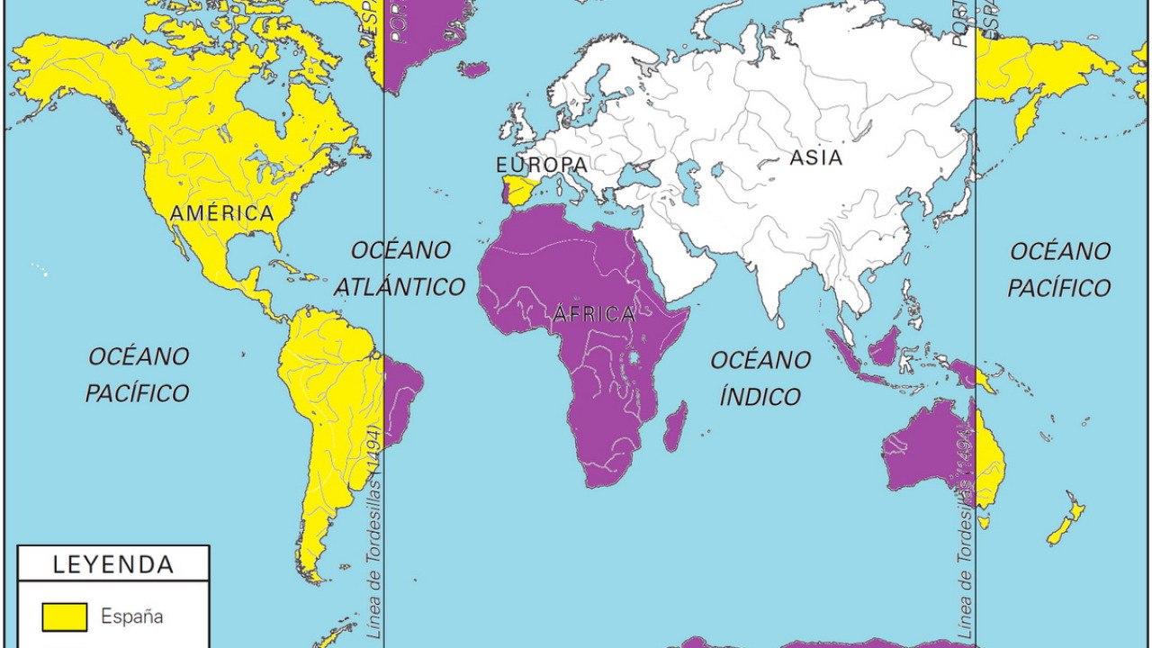
With Spain and Portugal competing for new lands outside of Europe, the Pope established a Line of Demarcation in 1493. Spain could claim all the land west of the line and Portugal could claim the land east of the line.

Slide 3
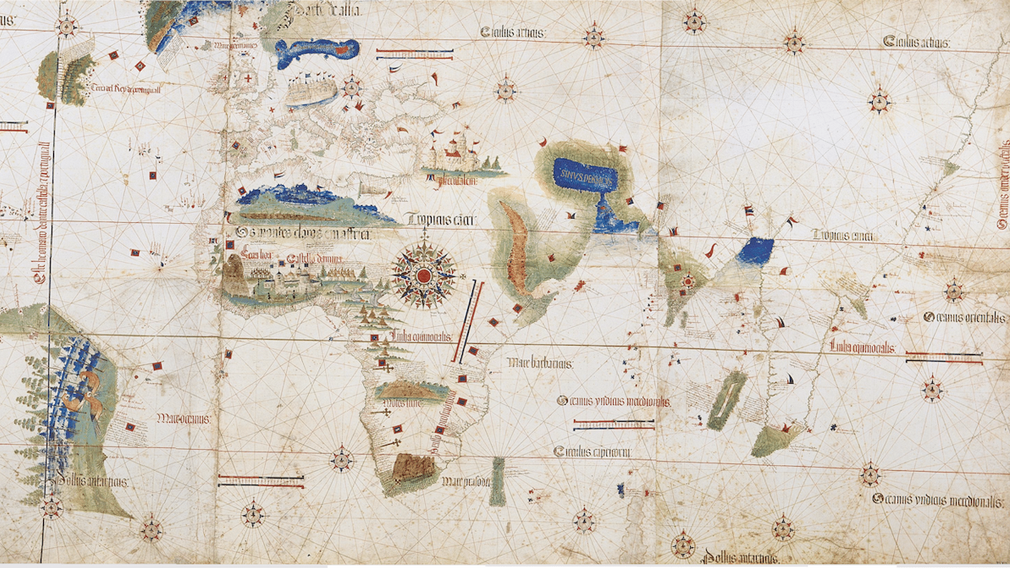
Remember though, at this time they thought they were only dividing Asia and Africa. They did not know Columbus reached two new continents.

Slide 4
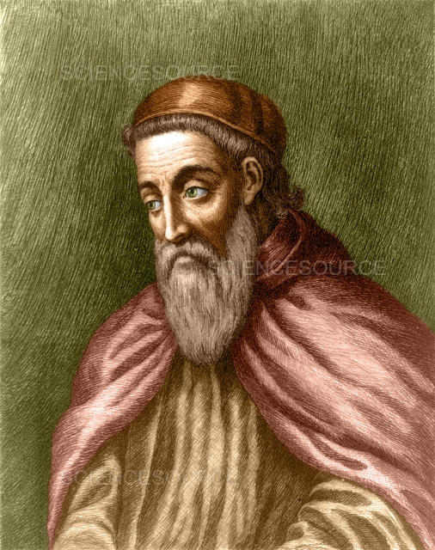
In 1501, Amerigo Vespucci realized that this land being explored was not Asia, but a new continent eventually named after him. America became known as the “New World” and Europe was referred to as the “Old World”.

Slide 5
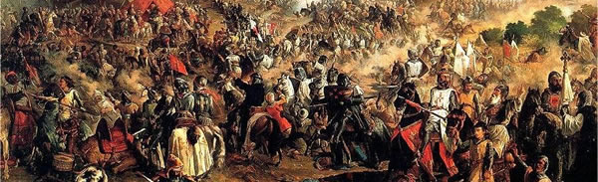
In Spain, they recently went through the Reconquista, or reconquest, in which the king and queen fought to take back control of all of Spain from the Moors. The Moors were North African Muslims living in Spain.

Slide 6
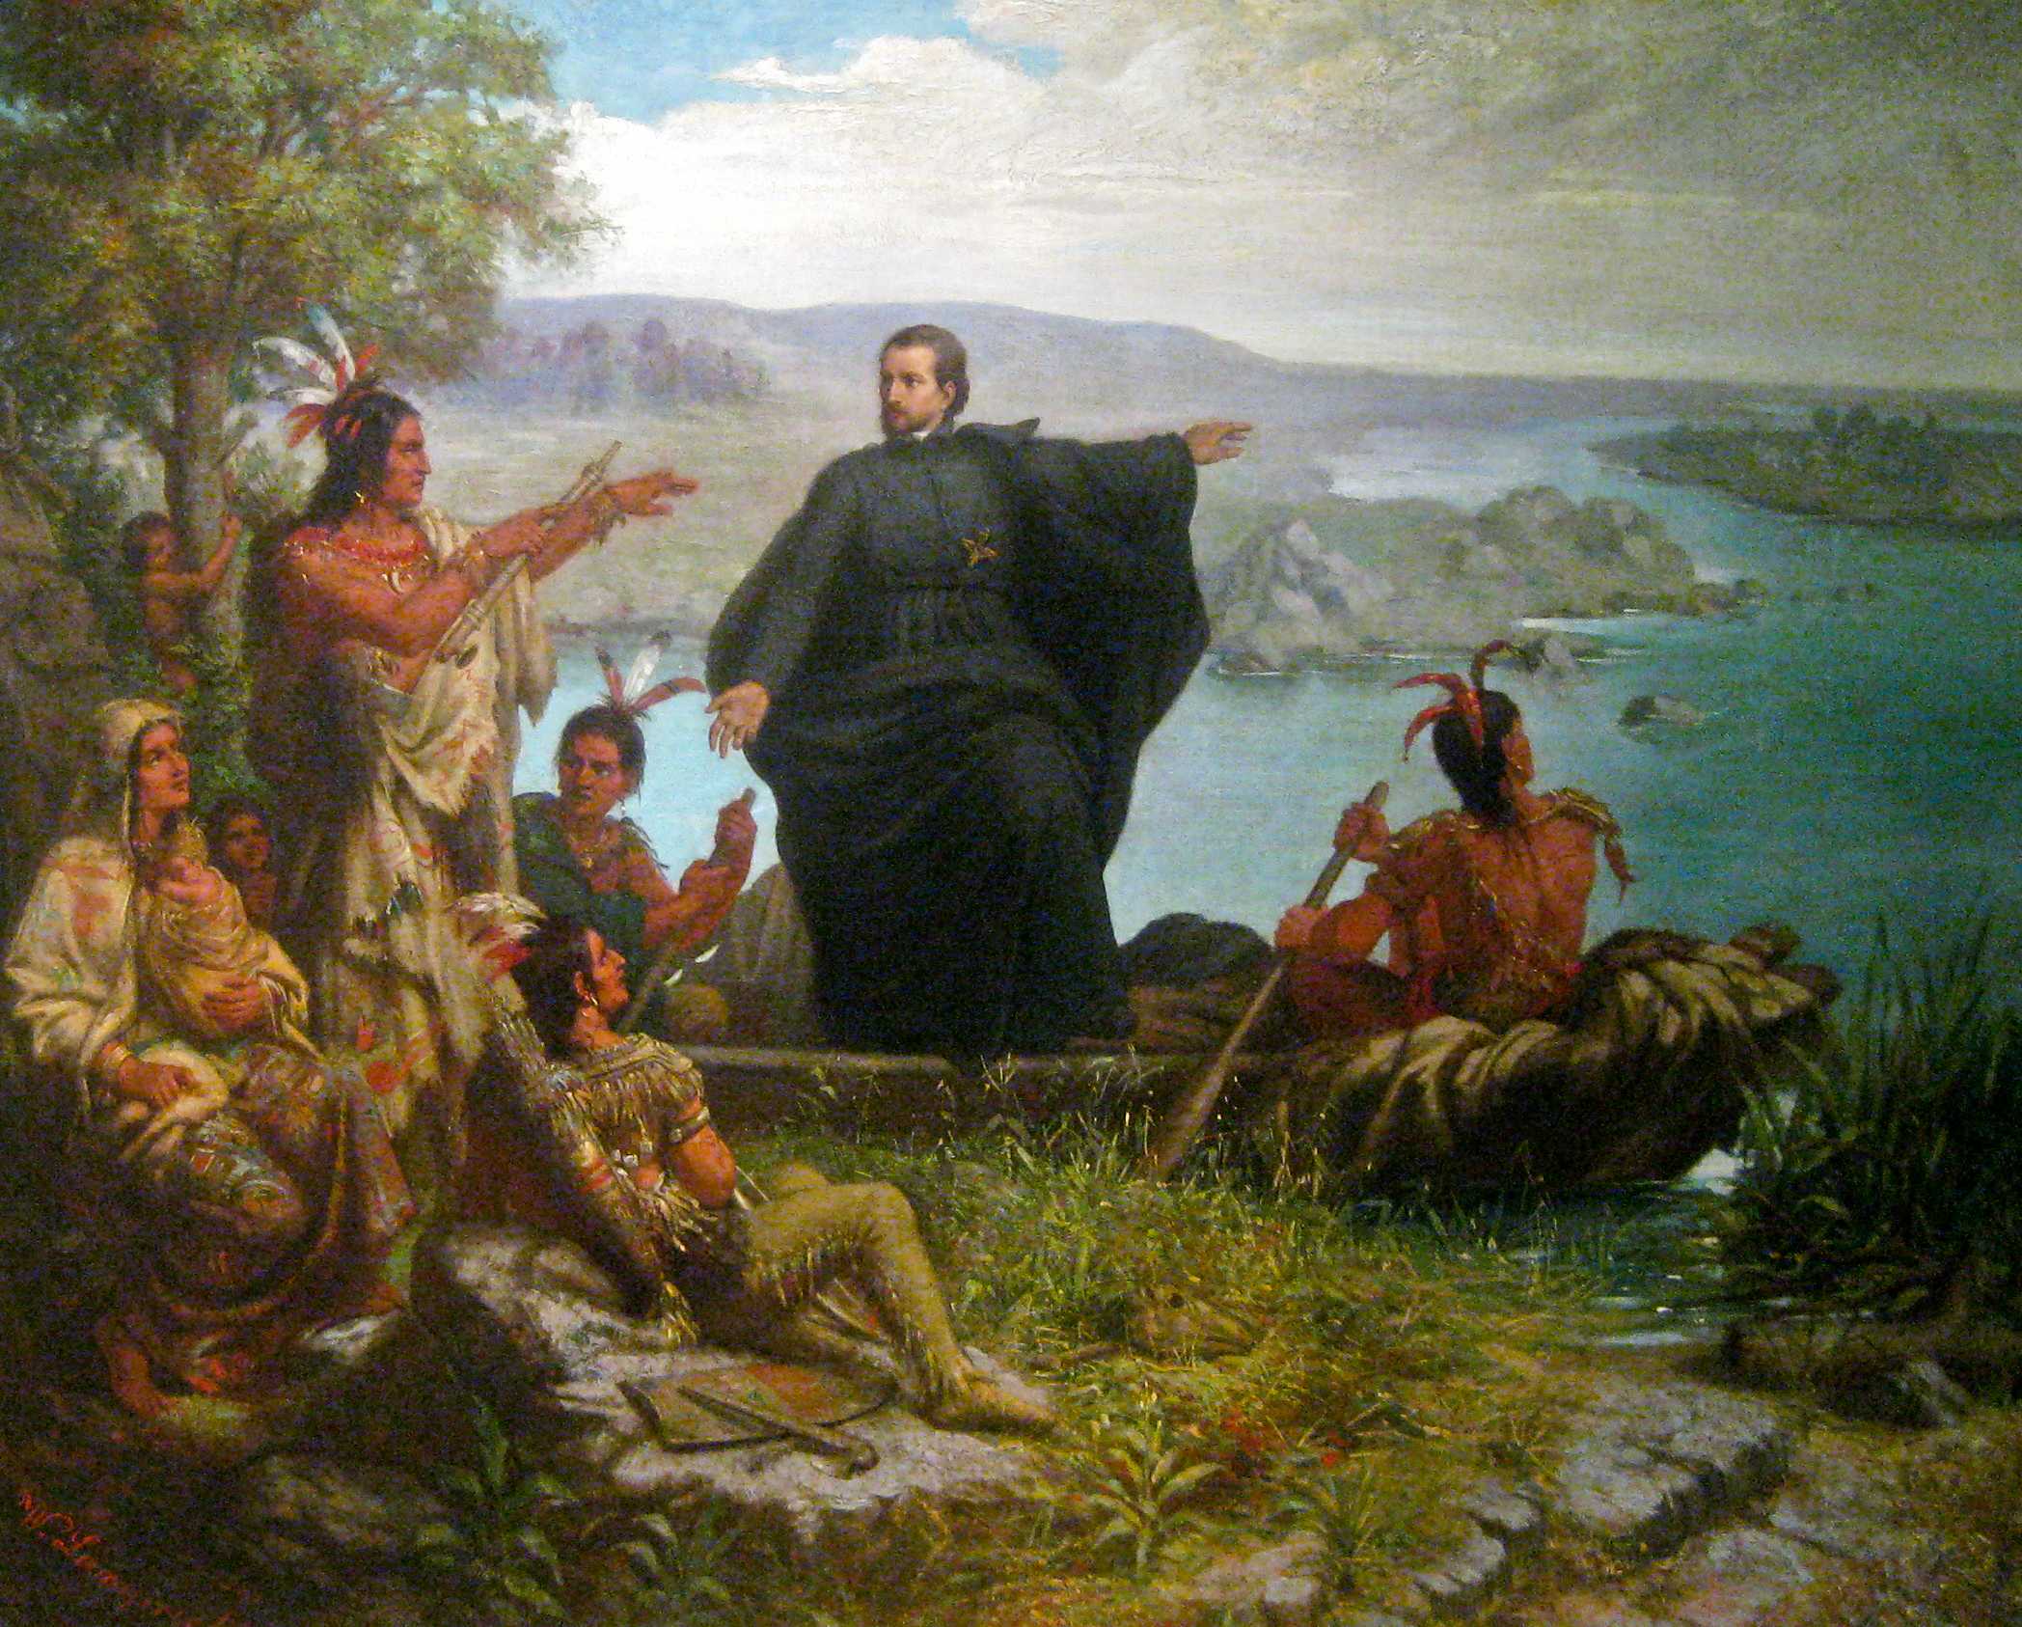
This idea of uniting Spain under one religion, Catholicism, was also carried over to America by the Spanish.

Slide 7
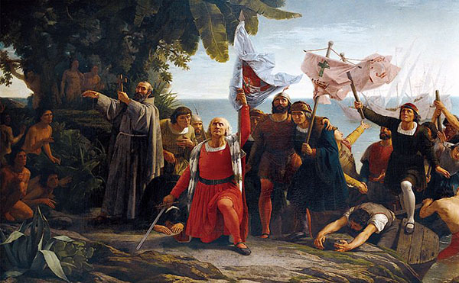
The idea of God, gold, and glory drove the Spanish to conquer new lands in America, eventually creating a Spanish empire.

Slide 8
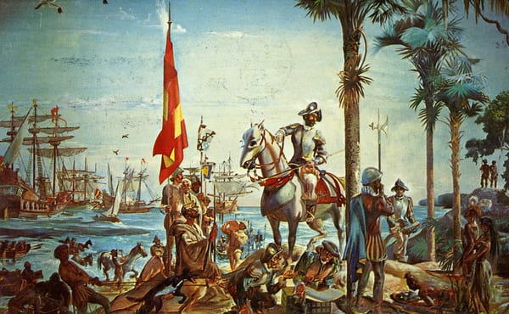
Unfortunately, the desire for riches and power often overshadowed the purpose of peacefully trying to convert Natives to Catholicism. Both conquistadors and priests journeyed to the “New World”.

Slide 9
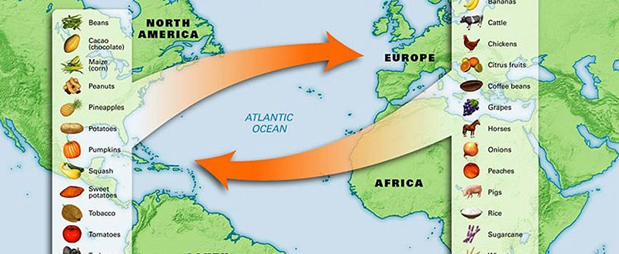
Soon many goods were being sent between the “New World” and the “Old World”. Read pages 64-65 in the textbook to learn about The Columbian Exchange.

Slide 10
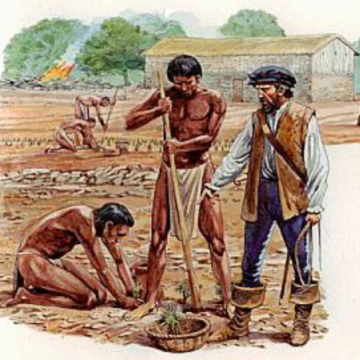
Many Natives were forced into slavery to work to provide goods transferred in the Columbian Exchange. The labor system that developed became known as Encomienda.

Slide 11
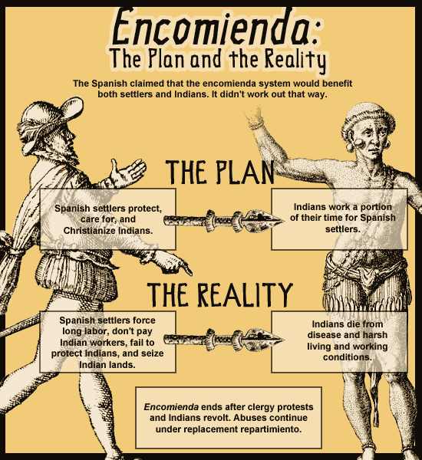

Slide 12
Some Spanish settlers knew that how the Natives were being treated was wrong and tried to do something about it. One was a priest named Bartolome de Las Casas. He became known as the “Protector of the Indians” for his efforts.

Slide 13
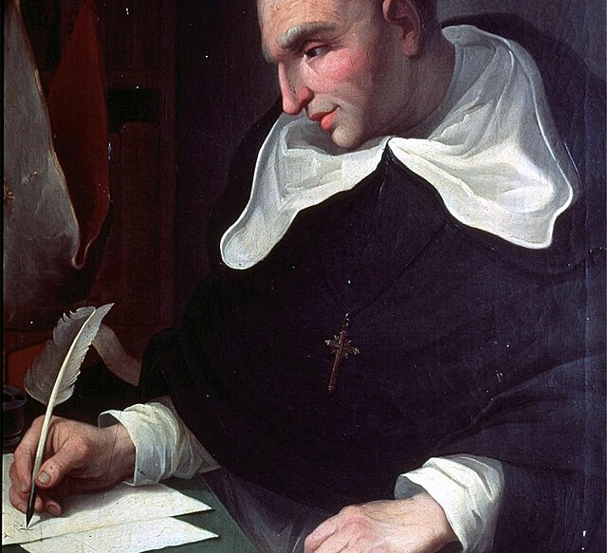
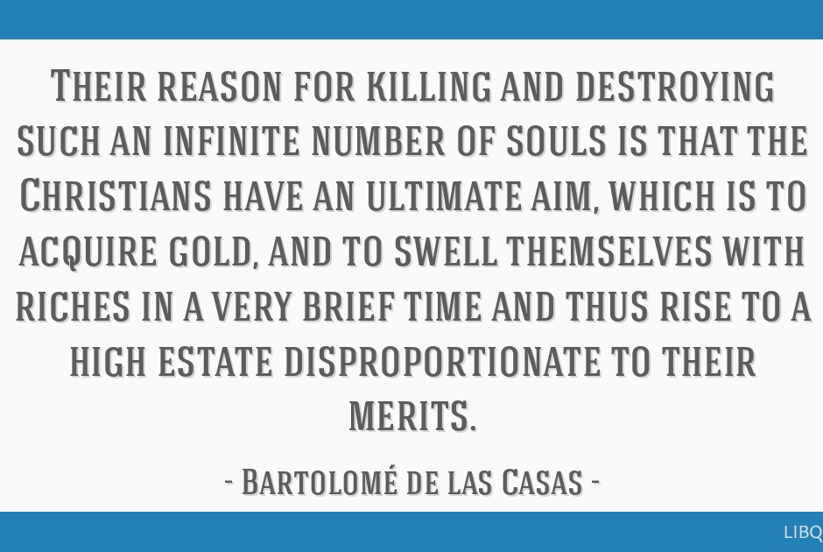

Slide 14
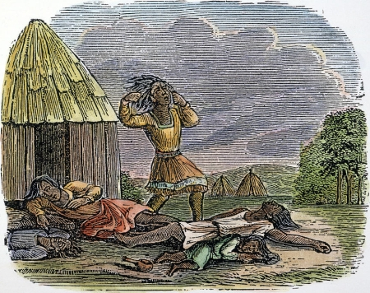
In time, however, most of the Native population died off from disease and harsh treatment.

Slide 15
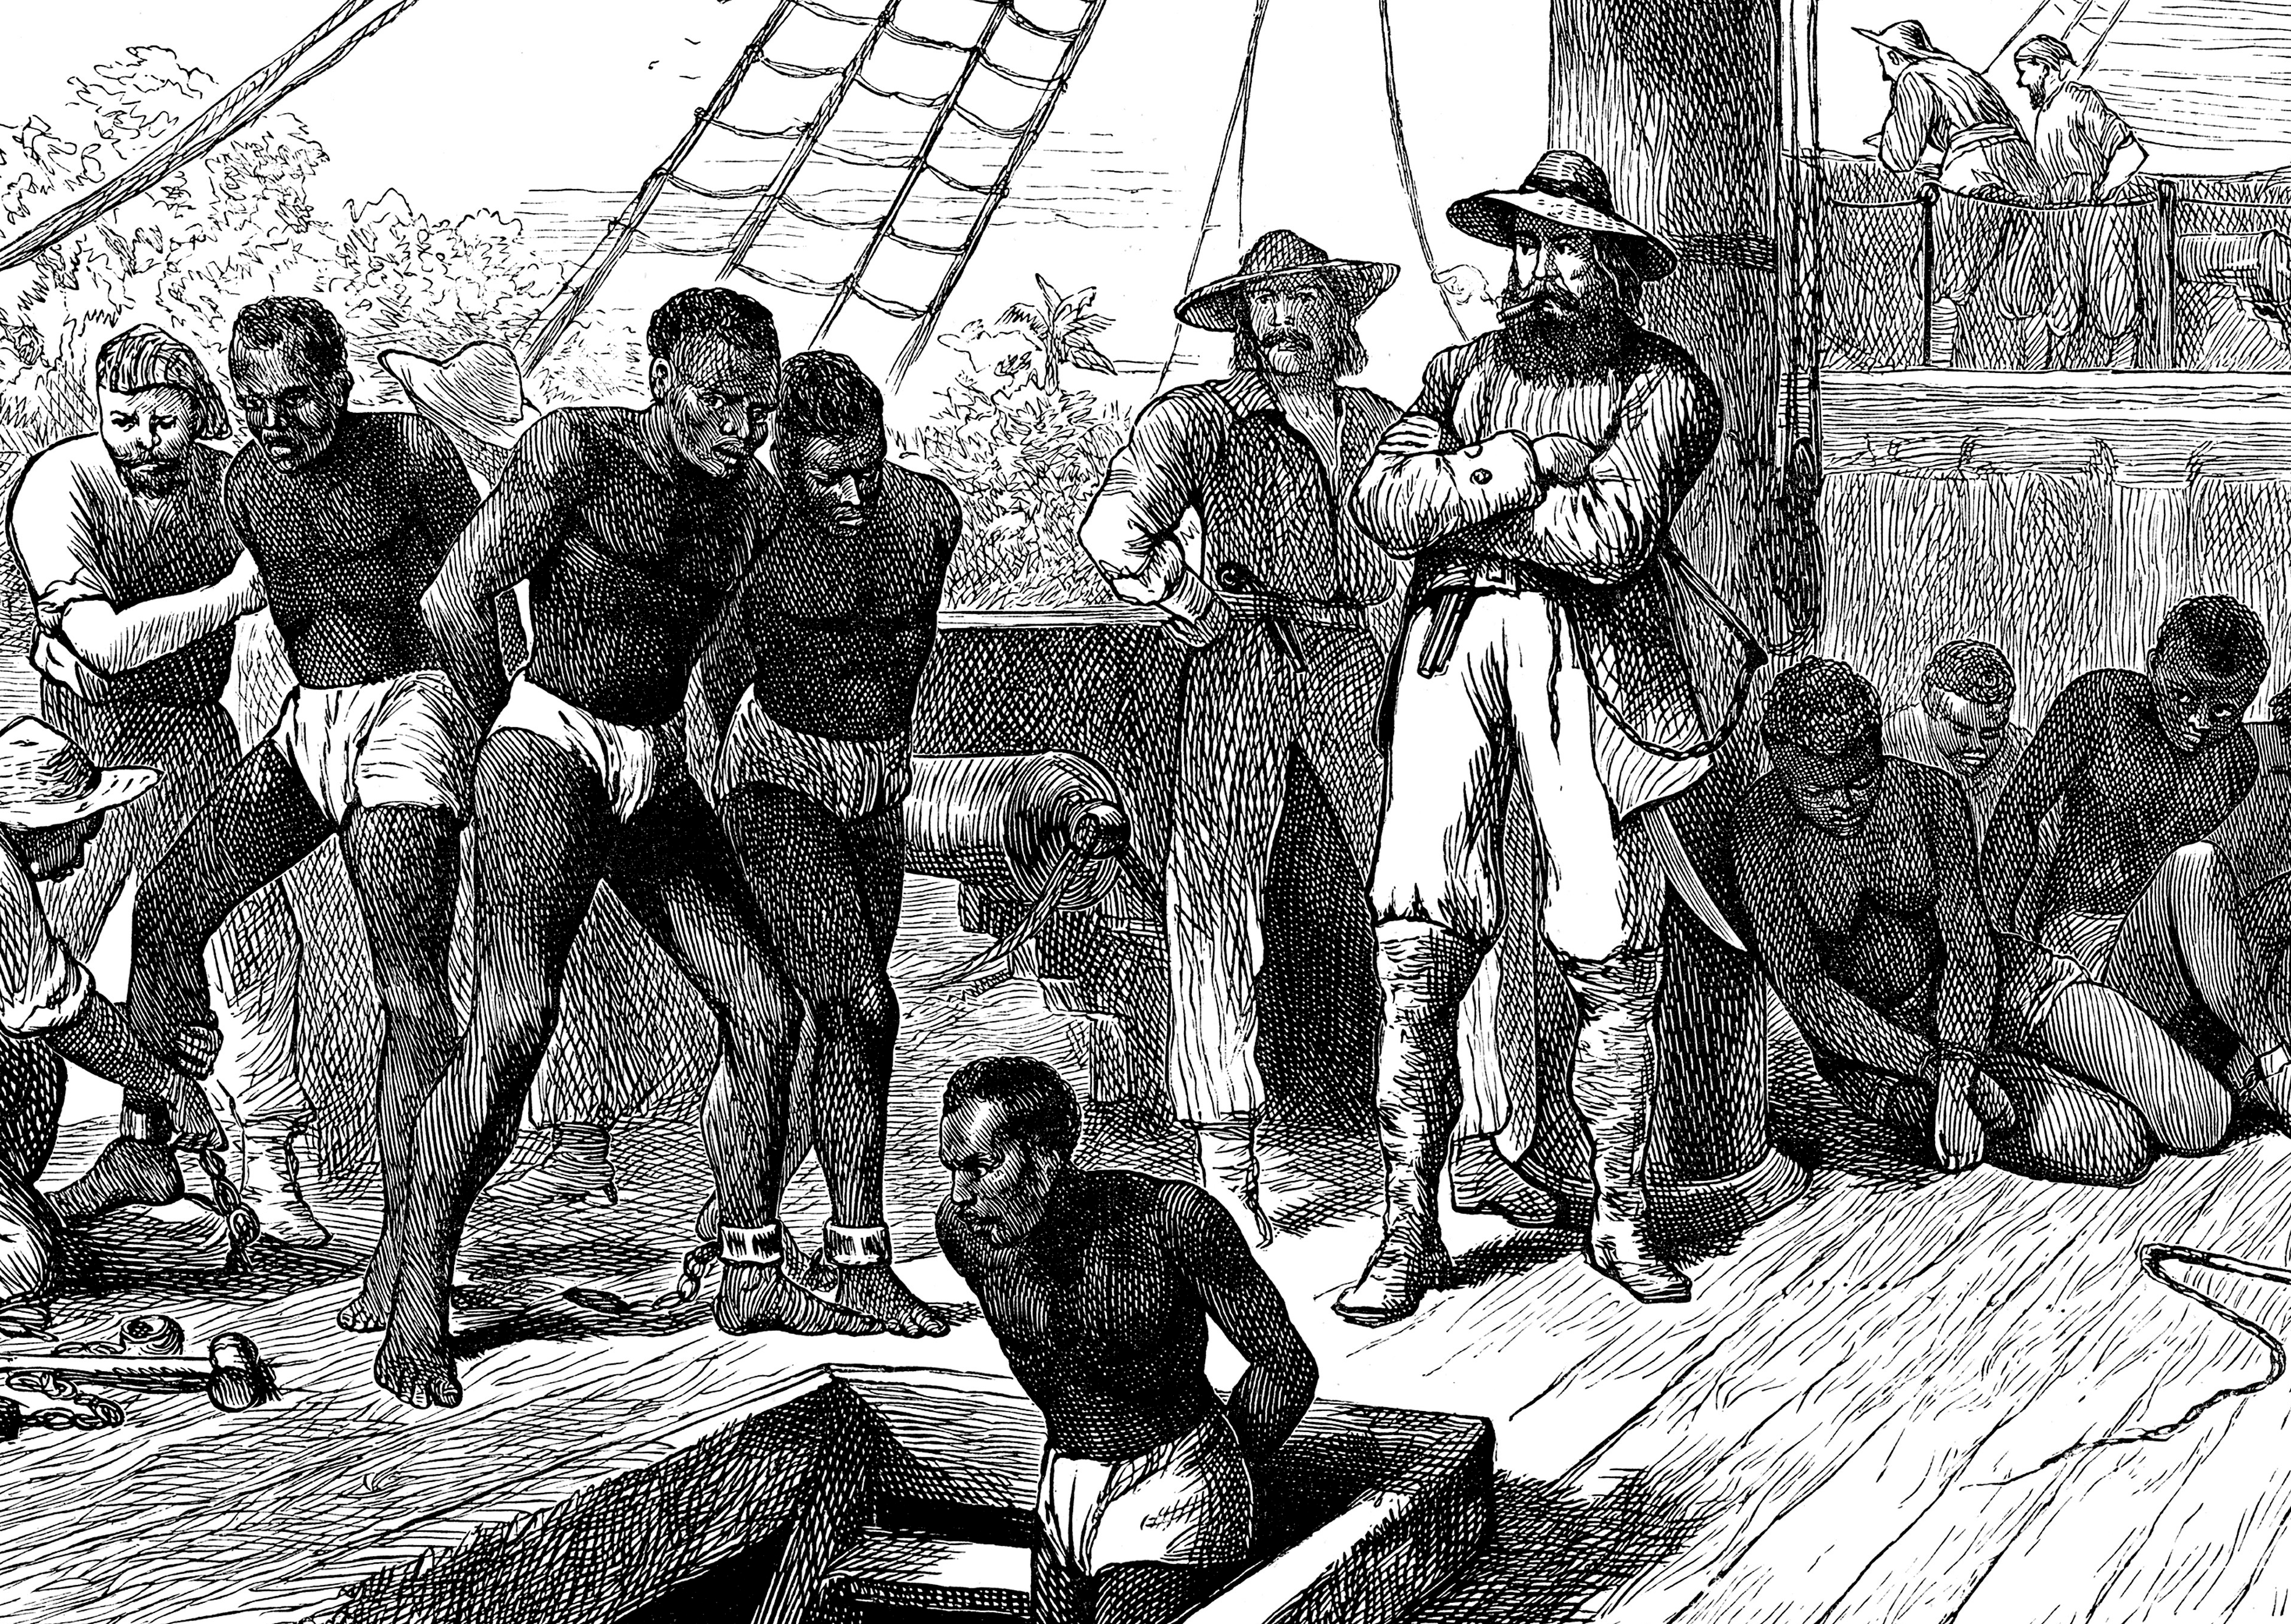
This lack of labor caused the Spanish to look elsewhere for workers. The Spanish sent slaves from Spain and Asia, but there was not enough of them for the demand. Eventually, slaves from Africa were brought to America.

Slide 16
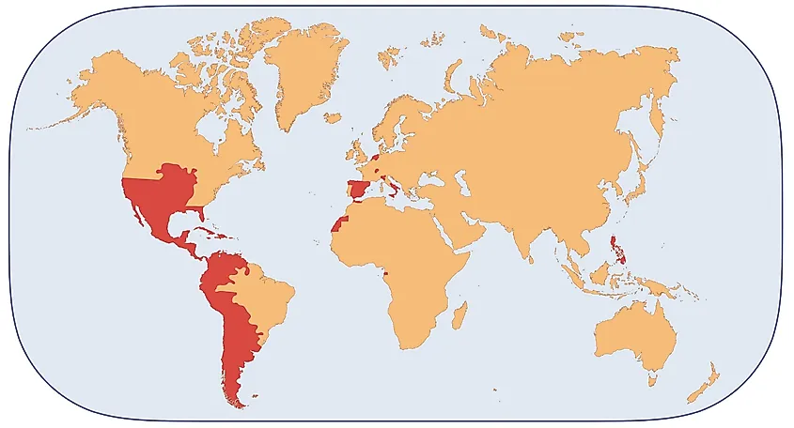
In time, many Spanish colonies were established in the Americas. A colony is an area controlled by a distant country.

Slide 17
